Slide 1

Advisory Board Meeting (electronic) December 4, 2012
Introductions
Project updates
Upcoming plans
Q&A and discussion
Spring 2013 AB meeting

Slide 2

Phenoscape Advisory Board
Members
John Day-Richter (Google)
Brian K. Hall (Dalhousie University)
Cyndy Parr (Encyclopedia of Life)
Alan Ruttenberg (stepping down)
Paul Schofield (University of Cambridge)
Peter Vize (University of Calgary)
Roles
Evaluate goals, plans, progress
Share knowledge, suggest opportunities
Help prioritize activities, ameliorate risks
Meetings
Annual virtual AB meeting
Annual F2F project meeting

Slide 3
Phenoscape project team
National Evolutionary Synthesis Center (NESCent)
Todd Vision
Hilmar Lapp
Jim Balhoff
Peter Midford
Prashanti Manda (starting Feb 2013)
University of South Dakota
Paula Mabee
Wasila Dahdul
Alex Dececchi
University of Oregon (Zebrafish Information Network)
Monte Westerfield
Yvonne Bradford
Ceri Van Slyke
Oregon Health & Science University
Melissa Haendel
University of Chicago
Paul Sereno
Nizar Ibrahim
Mouse Genome Informatics
Judith Blake
Terry Hayamizu
Cincinnati Children's Hospital Medical Center
Aaron Zorn (Xenbase)
Christina James-Zorn (Xenbase)
California Academy of Sciences
David Blackburn
University of Arizona
Hong Cui
Zilong Chang
Lawrence Berkeley National Labs
Suzi Lewis
Chris Mungall
Notes:
Use this as a reference for names.

Slide 4
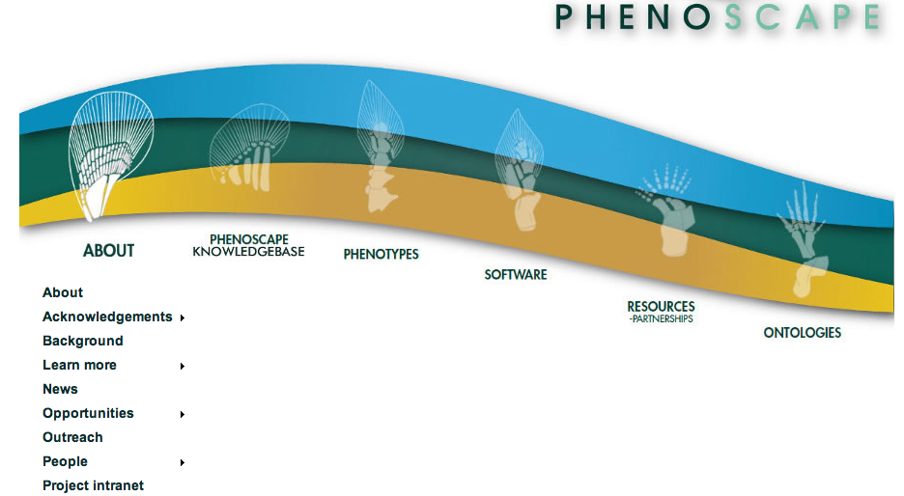
NSF: July 1, 2011-June 30, 2015
Notes:
Website & wiki: http://phenoscape.org
Funding: $3.3M in 2 NSF awards to U South Dakota (Mabee) and U North Carolina/NESCent (Vision)
Knowledgebase: http://kb.phenoscape.org
Blog: http://blog.phenoscape.org

Slide 5
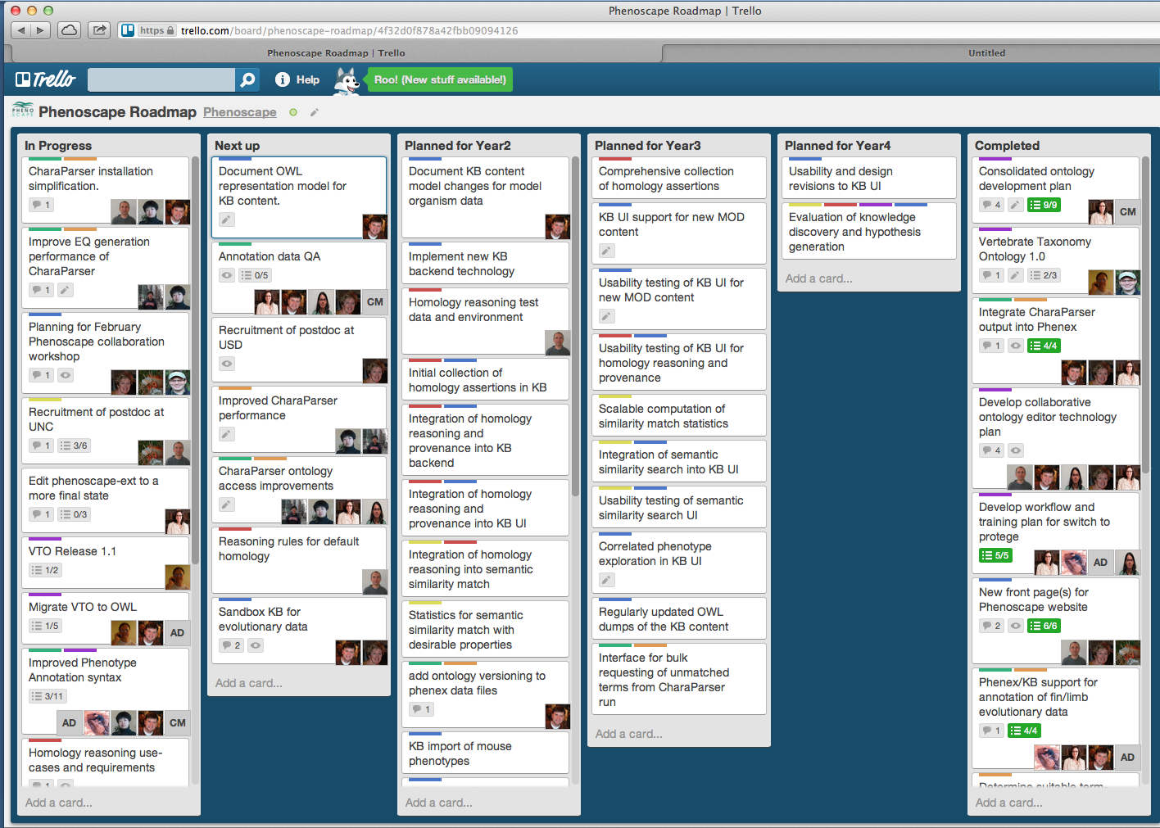
Phenoscape activities overview
Phenoscape roadmap on Trello: http://bit.ly/HDniSS
Notes:
A more detailed and frequently updated view of where Phenoscape activities are focused is available here: https://trello.com/board/phenoscape-roadmap/4f32d0f878a42fbb09094126

Slide 6
Report of Phenoscape Scientific Advisory Board (27th April 2012)
Consider other large scale sources of structured data (Todd)
Further analyze candidate genes by incorporating gene set and pathway analysis for additional value to users (Todd)
Outreach, identification of user groups and real-life use-cases (Todd)
VAO and Uberon merge into one cross-species anatomy (Melissa)
Quality of the phenotype data capture, annotations (Alex)
Capturing inter-individual variation within taxa (Alex)
Practicality and utility of capturing data from birds and humans (Melissa & Monte)
Distribution of effort into developing tools vs. data capture & curation (Todd)
Concern over ontology term brokering with the NCBO tools (Jim)
Improvement in the granularity of phenotype descriptions, PATO (Alex)
Notes:
Advisory board concluded that ‘Points 1,2,3 and 9 are the most pressing issues at the moment and should be addressed over the next year of the project.’

Slide 7
II. Project updates
Curation workflow (Hong Cui, Jim Balhoff)
Ontology development (Melissa Haendel, Peter Midford)
Phenotype curation (Alex Dececchi, Monte Westerfield)
Homology reasoning (Hilmar Lapp)
Semantic similarity (Todd Vision)
Outreach (Nizar Ibrahim)
Knowledgebase development (Jim Balhoff)

Slide 8
1. Curation workflow 1a. Scalable Workflow: NLP
Main goal
To speed the curation of phenotype descriptions
To improve the specificity of the annotation (“shape” -> “U-shaped”)
Progress made since the last meeting
Removing CharaParser’s dependency on relational database, Perl etc.
Addressing issues identified in the BioCreative workshop , April 2012
Issues
Group 1: From plain text to XML (machine understanding text description)
Group 2: From XML to EQ (ontologizing the understanding)
Addressed most Group 1 issues that have been identified.
Notes:
General procedure taken in addressing group 1 issues:
1. Identify patterns in human curation results
2. Code to make CharaParser correctly recognize and process these patterns
3. Test the implementation

Slide 9
Issues Addressed
Self-referred terms
Eg. “counterpart” -> the entity itself
Adjective -> Noun +absent/present
Eg. Unossified -> E: ossification of …; Q: absent
Connection/separation
Eg. Connection between A and B presents-> A in contact with B

Slide 10
Issues Addressed
BSPO (Spatial Ontology)
Mapping to non-synonyms in ontology
Eg. proximal portion -> proximal region
Implicit part_of relation
Eg. anterior coracoid process ->
anterior region(part_of (coracoid))
Spatial terms used as adverbs
Eg. … red dorsally -> dorsal region of … is red

Slide 11
Currently Working on
Relational Slim
Providing methods to retrieve all terms in relational slim -- optimization of ontology lookup
Enforce: If entity and related entity are both present, the quality must be from relational slim
Binary statements (absent/present, yes/no)
“quadrate , dorsoventrally oriented crest located on the posterior side “
absent
present

Slide 12
Future Plans
Working with others (Melissa, Jim, Wasila, Alex, etc.) to identify curation patterns
Implement these patterns in CharaParser.EQ Generator
Address group 2 issues (i.e., XML to EQ) by better utilizing the knowledge coded in ontologies

Slide 13
1. Curation workflow 1b. Ontology Term Broker
Goal: remove bottleneck created by encountering missing ontology terms during annotation work
Progress since April 2012: working system is in place⁹
Phenex request interface
Provisional term management web interface
Phenex auto-update of implemented provisional terms
Lightweight solution: meets our needs, avoids development of elaborate back-end by using Bioportal provisional term services
Notes:
9. Advisory Board: concern over implementing the ontology term broker with NCBO tools

Slide 14
Term broker workflow
Request missing terms from within annotation interface
Receive provisional term ID to use in annotation
Asynchronously, edit ontology to add new terms and update provisional term record with permanent ID
References to provisional terms are automatically migrated to permanent IDs

Slide 15
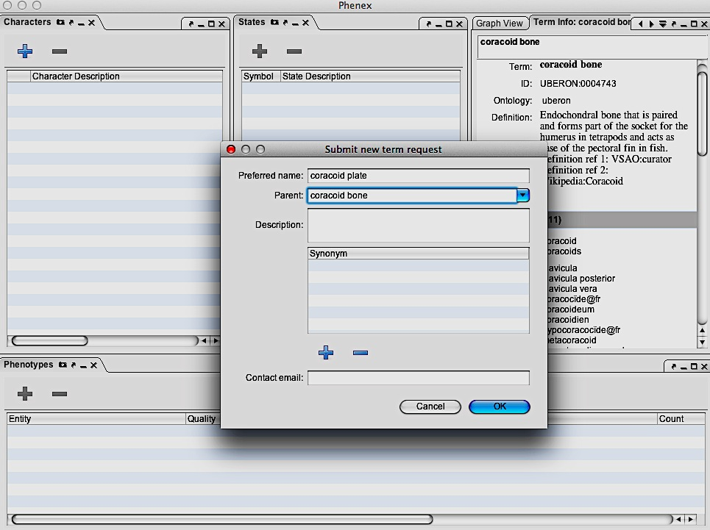
Request a term, immediately available for use in annotation

Slide 16
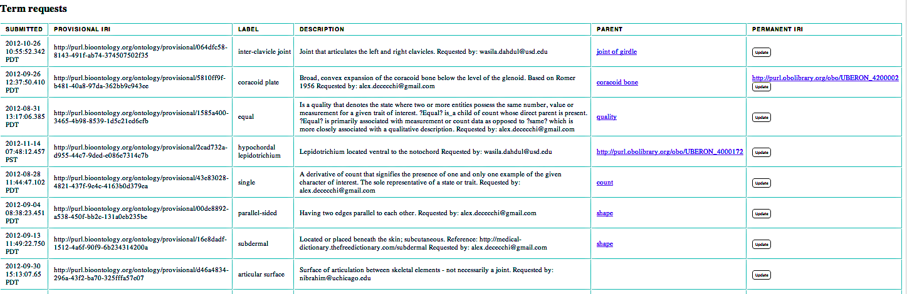

View requests in web interface

Slide 17
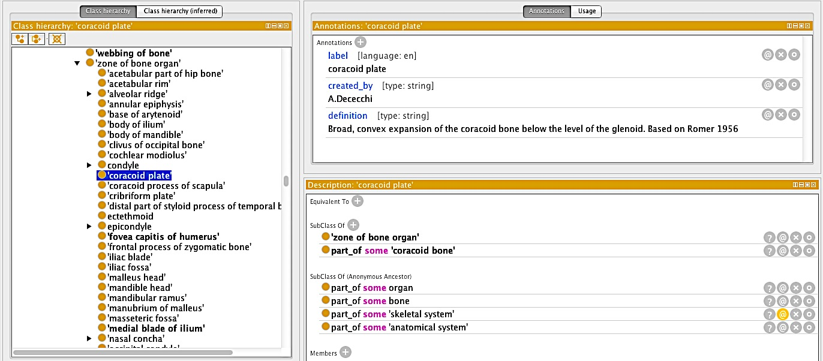
Edit ontology

Slide 18
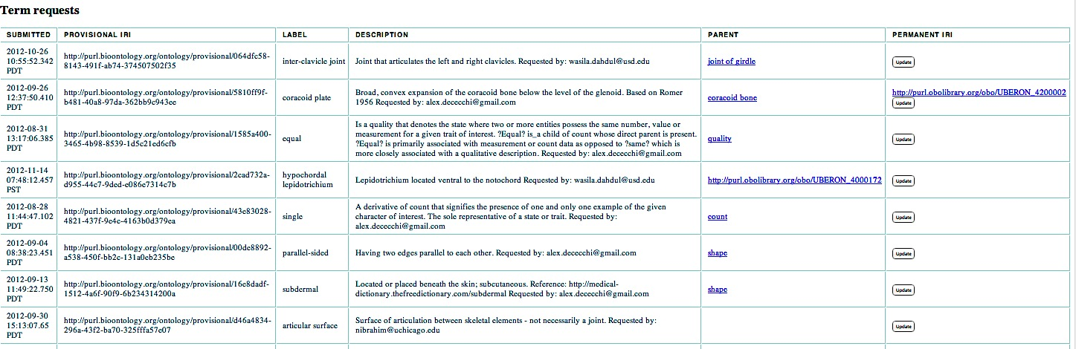
Update permanent IRI in web interface; Phenex will auto-update references to the provisional ID
Notes:
IRI=Int’l Resource Identifier, a generalized URI that permits Unicode characters

Slide 19
Next six months
Improve provisional term web interface
Add ability to correct typos in labels, definitions
Interaction of web interface with ontology trackers
Each ontology has a different request system
Add field to note which terms have been submitted to an ontology tracker

Slide 20
2. Ontology Development 2a. Anatomy
Objectives: Coordinate the development and alignment of vertebrate anatomy ontologies, with focus on the limb/fin skeleton
Anatomy ontologies provide the entity term in in phenotype annotations
Limb/fin transition is key Phenoscape use case
Integration across the various ontologies is required to support cross-species queries
Logical definitions required for inference and analysis
Participants: David, Wasila, Alex, Melissa, Nizar, Paula, Chris, Paul

Slide 21
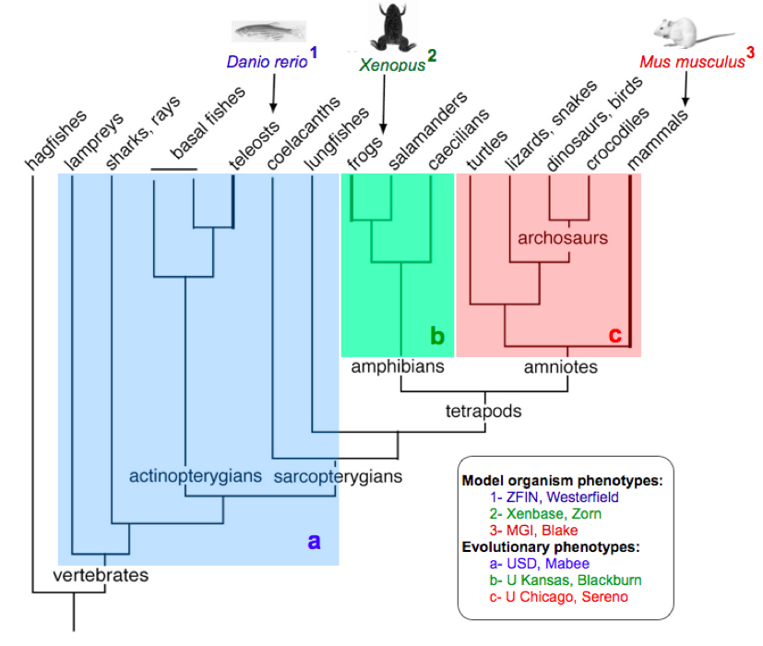
Taxa/model organism anatomy relevant to Phenoscape
zebrafish
Xenopus
mouse
teleosts
amphibians
amniotes
vertebrates

Slide 22
Recommendations from April Advisory Board Meeting
4. VAO and Uberon merge into one cross-species anatomy ontology
Coordination and allocation of responsibilities and edit rights should be sorted out
7. Examine the practicality and utility of capturing data from birds and humans using new VAO/Uberon ontology

Slide 23
What have we achieved?
Released VAO as VSAO (Vertebrate Skeletal Anatomy Ontology) to be consistent with our PloS One paper in press (see PONE-D-12-15442R2 “A unified anatomy ontology of the vertebrate skeletal system”)
Created one ontology file “phenoscape-ext” with distributed editing
http://phenoscape.svn.sourceforge.net/viewvc/phenoscape/trunk/vocab/edit/phenoscape-ext.owl?view=log

Slide 24
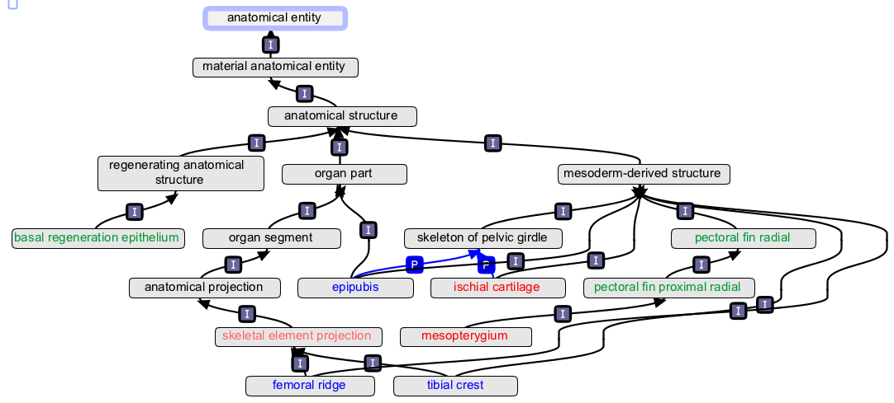
Phenoscape-ext
Where there existed an equivalence axiom in uberon to a TAO, AAO, or VSAO class, the classes were rolled up into an uberon-core class.
Subclasses from these ontologies are retained as uberon subclasses within specific ID ranges for each
Existing defs from TAO, AAO, VSAO are preserved using ‘external definition’ property and annotated with the source

Slide 25
Ontology workflow
Adopted Protégé 4 ontology editor and OWL2 format
Trained ontology curators in use of SmartSVN, Protégé, and phenoscape-specific ontology editing workflow (also they attended NESCent Anatomy Ontology course)
Ongoing weekly hands-on ontology edit training
Documented workflows for ontology editing http://phenoscape.org/wiki/Ontology_workflow
Fast access during annotation to changes in phenoscape-ext by Phenex, immediate access to temporary terms via the Term Broker

Slide 26
Ontology Attribution
One concern was how to property attribute ontology contributions. We now have the following:
Definitions are annotated with source
‘created_by’ property to indicate term editor
Specific property ‘external_definition’ that is annotated with the source

Slide 27
Next six months
Address outstanding TAO tracker items
Continue further defining ingested classes
Obsoleting redundant or incorrectly generalized classes
Updates based on serial homology discussions at RCN (e.g. digit count, etc.)
Enhance further avian-specific anatomical structures (many in uberon already)
Use ORCID IDs to for author annotation (as per developing OBO Foundry best practices)

Slide 28
2. Ontology development 2b. Taxonomy
Vertebrate Taxonomy Ontology (VTO)
Not itself an authoritative taxonomy
But derived from authoritative and widely used sources
Participants: Peter, Jim, David, Alex, Nizar
Since April
Interoperability with NCBI identifiers
Integration with PaleoDB
Add xrefs to Fishbase species pages

Slide 29
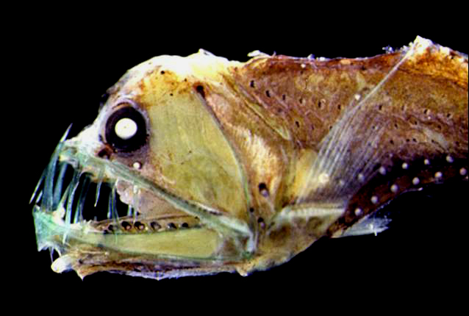
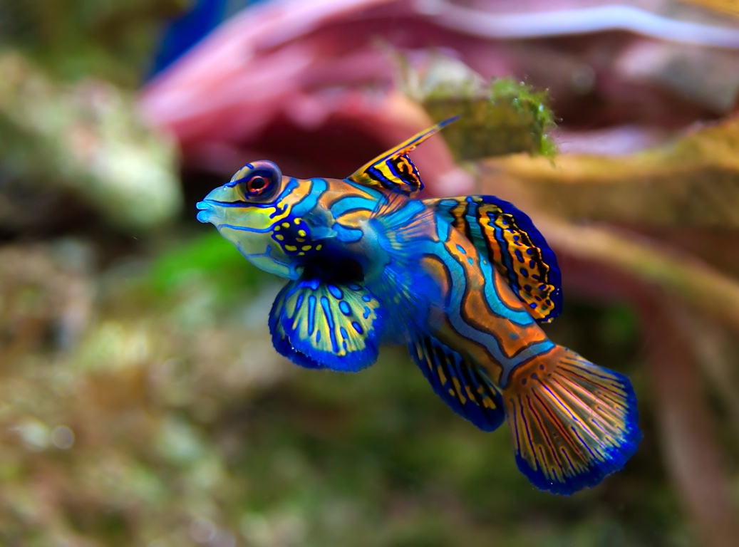
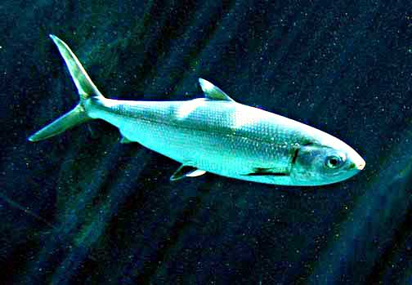
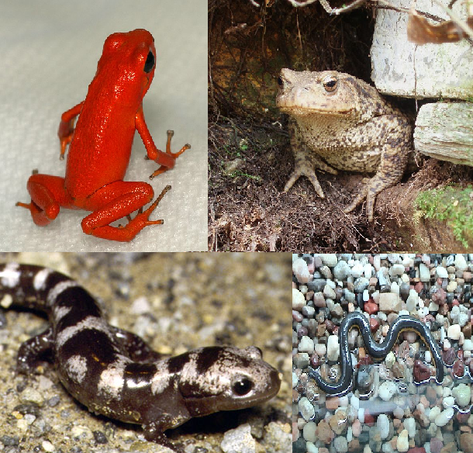

VTO building blocks
Catalog of Fishes
TTO
Taxa: 38K
Species: 32K
Synonyms: 58K
ATO
AmphibiaWeb
VTO
Taxa: 104K
Species: 89K
Synonyms: 82K
Curation
NCBI Taxa
PaleoDB
http://purl.obolibrary.org/obo/vto.owl

Slide 30
Releases
July 2012
VTO - no VTO identifiers; incorporated PBDB
November 2012
VTO - NCBI, PBDB update; Fishbase links; resolve some release process issues
December 2012
ATO - AmphibiaWeb update
TTO - update from CoF, resolve a few problems found in VTO release
VTO - updates from NCBI, TTO, ATO, PBDB, resolve basal tetrapod issues, go though release process with Jim

Slide 31
Next steps
Stable tool ready to be used
VTOTool can generate VTO and ATO updates using appropriate scripting
Now generates OBO that is compatible with the OBO Ontology Release Tool
Updating wiki documentation in December
How to maintain and execute scripts

Slide 32
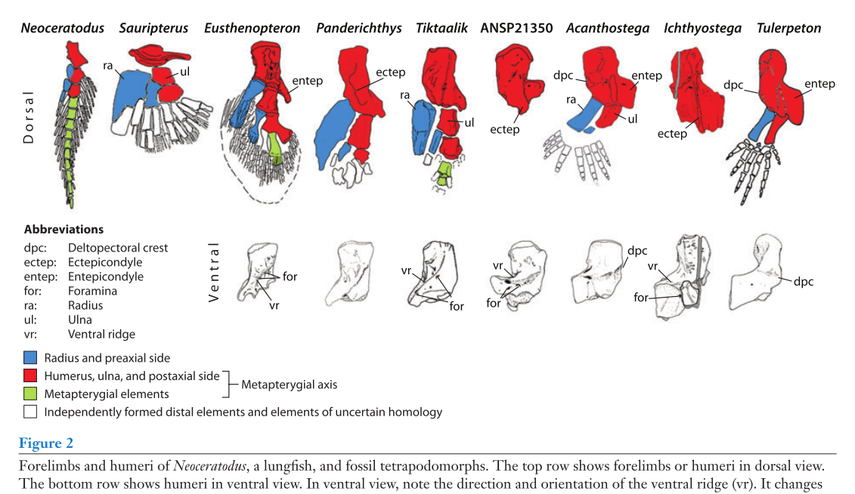
3. Phenotype curation 3a. Evolutionary data
Motivation: fin/limb species phenotypes from published literature required for capstone test case
Clack, J. A. (2009). The Fin to Limb Transition: New Data, Interpretations, and Hypotheses from Paleontology and Developmental Biology. Annual Review of Earth and Planetary Sciences, 37(1), 163-179
Participants: Wasila, Alex, Nizar, Melissa, Paula, David, Paul

Slide 33
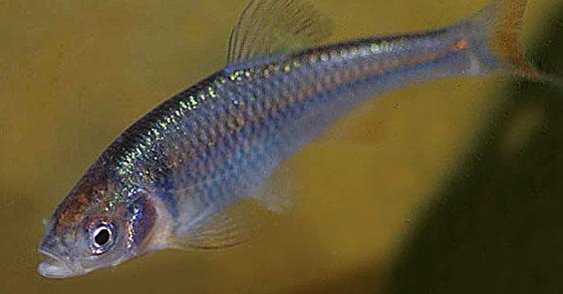
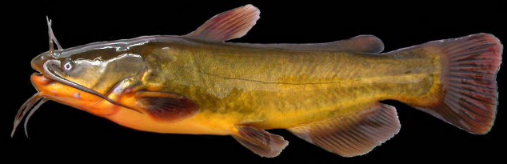
Phenotype annotation of taxon
Vertebrate Taxonomy Ontology
(104, 746terms)
species 1
species 1
Uberon Anatomy Ontology
(10520 terms; 27743 synonyms)
Quality Ontology (PATO)
(1,363 terms, 753 synonyms)
species 2
Taxon | Entity | Quality
species 1 | Head | cylindrical
species 2 | Head | flat

Slide 34
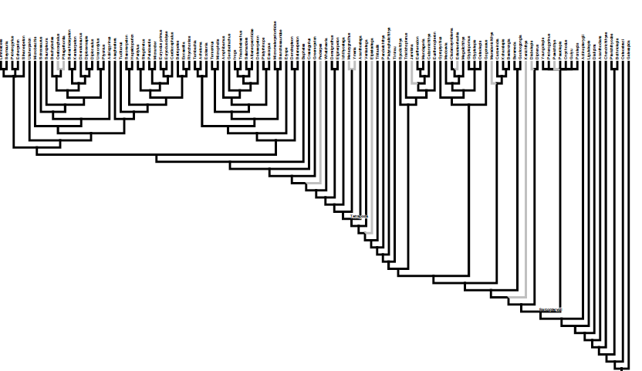
Taxonomic scope of annotation
Tetrapoda
Fishes
Amniotes
Amphibians

Slide 35
Curation objectives
Taxon | curator | # of papers | # of fin/ limb characters | # characters curated to date
Fishes | Wasila | 19 | 218 | 108 (49%)
Amphibians | Alex | 41 | 888 | 584 (66%)
Amniotes | Nizar | 6 | 295 | 164 (56%)
Amphibian dataset: 653 OTUs
Minimum of 41318 annotations to OTU
First draft of curation is targeted for completion by January 1st 2013

Slide 36
Curation software improvements
ORB (ontology request broker) function permitting the creation of temporary term id’s has increased curation rate.
Polymorphism support⁶.
Requested term addition to Phenoscape ext file ongoing
Notes:
From report: capture inter-individual variation (polymorphism)

Slide 37
Annotation quality control⁵
Goal: improve inter-curator consistency in annotation
Items completed:
Relational qualities: Analyzed annotations to determine which relational qualities (e.g., ‘fused with’) should be used in phenotype syntax for EQE
Reviewed all annotations for consistency in use of relational qualities
Proposed “annotation checker” panel for Phenex; provides user with feedback on use of relational qualities
Notes:
5. From report: concerns about quality of phenotype data capture, annotations

Slide 38
Annotation quality control⁵
Relations used in post-composition (in progress)
Determine which relations (e.g., anterior_to) should be used for post-composed entities
Analyze list of relations used in annotations and relations used in Uberon
Analyze annotations for consistency in use of relations
Constrain the post-composition editor in Phenex to the list of “approved” relations

Slide 39
PATO term additions¹⁰
PATO
14 PATO terms, 2 synonyms added since June 2011
2 other changes (updated definition)
38 provisional terms created (ORB)
Met with George Gkoutos in RCN meeting, October 2012
Notes:
10. From report: It was clear that improvement in the granularity of phenotype descriptions could be achieved with further development of PATO and we encourage Phenoscape to interact closely with the PATO developers to get the terms they need.

Slide 40
3. Phenotype curation 3b. Model organisms: (Monte, Ceri, Yvonne, Aaron, Christina, Judy, Terry)
zebrafish
Xenopus
mouse
teleosts
amphibians
amniotes
vertebrates

Slide 41
Model organism phenotypes
Aim
Annotate skeletal phenotypes for fin and limb for genetic mutants from zebrafish, Xenopus, and mouse
Milestones
Curation of phenotypes & gene expression
Finalize what phenotype data will be imported into Phenoscape KB
Develop pipelines for uploading Xenbase and MGI data to Phenoscape
Incorporate phenotype & gene expression into KB

Slide 42
Model organism phenotypes
Progress – ZFIN (April - November 2012)
65,708 phenotypes for ~4543 genes (+14%)
852 fin phenotypes
2167 publications with phenotypes
Includes 7 direct submissions with 11,624 phenotypes

Slide 43
Model organism phenotypes
Progress – MGI
2000 limb phenotypes for ~450 genes
Phenotypes curated as ~150 MP (mammalian phenotype) terms
MP terms mapped to EQ (complete for limb)
Mappings are maintained up to date

Slide 44
Model organism phenotypes
Progress – Xenbase
Released new XAO v2.0.8 (in OBO foundry 10/23/2012)
Ongoing annotation of limb/fin gene expression
202 papers, 81 genes with expression images
Established Phenote configuration (with Jim Balhoff) to annotate limb/fin phenotypes

Slide 45
Model organism phenotypes
Immediate future plans – ZFIN
Continue curation
Import gene expression data into Phenoscape

Slide 46
Model organism phenotypes
Immediate future plans – MGI
Continue curation
Maintain limb MP->EQ mappings
Develop pipeline to import mappings into Phenoscape (nearly ready)
Import anatomy terms & developmental stages (EMAPA) into Phenoscape (soon)
Import gene expression data into Phenoscape

Slide 47
Model organism phenotypes
Immediate future plans – Xenbase
Continue curation
Finalize import of gene expression data into Phenoscape KB
Begin curating limb phenotypes

Slide 48
Model organism phenotypes
Deliverables
Complete & up-to-date phenotype & gene expression data for 3 model organisms
Add human (HPO) and bird data (RCN)⁷
Paper – methods & challenges of integrating such data
Notes:
7. Human and bird data

Slide 49
4. Homology Reasoning
Enable integration of phenotypes across the fin-to-limb transition in vertebrate evolution.
Fin and tetrapod limb skeletons represented by different classes
Yet parts are biologically the “same” by common origin, or by developmental program.
Enable computing over homology assertions as hypotheses.
Subclassing is often too strong: assertions conflict with each other and vary in acceptance.
Require attribution, evidence, and provenance.
Participants: Hilmar (coordination), Chris (logic formalization); Paula, David, Paul, Alex, Nizar (Comparative vertebrate morphology)
Notes:
The Phenoscape KB wants to enable mining phenotypes across the fin-to-limb transition in vertebrate evolution, and thus needs to integrate across the whole range of phenotypes. Because of their structural differences, a cross-vertebrate anatomy ontology focused on structural definitions of terms inevitably has to represent fin and tetrapod limb skeletons by different, and thus ontologically “different” classes. Yet, parts of the fin/limb skeletons are biologically speaking the “same”, due to common origin (phylogenetic homology) or due to arising from the same developmental program (iterative homology). The KB should return phenotypes of the “same” kinds of structures together, and semantic similarity metrics should score them as in close proximity.
Accomplishing this through simple subclassing is problematic. Homology assertions are hypotheses sometimes far from settled. As such, they need attribution and evidence to allow users to interpret the results. They can also conflict with each other, which with subclassing would lead to inconsistent ontologies. Furthermore, subclassing would require defining the ancestral state, or the “canonical” structure (e.g., “the” limb) that is being repeated. Hence, need a homology relationship together with its logic properties, a mechanism to capture annotated homology assertions from experts, and a data model to represent these within the KB.

Slide 50
Deliverables
Comprehensive collection of vertebrate fin/limb homology assertions.
Capture rigorous homology assertions in the KB.
OWL/RDF data model for representing homology in the KB.
Integrate homology-based results in KB user-interface.
Integrate homology into semantic similarity scoring.
Notes:
Requirements: Must include term IDs, evidence, and attribution, Incorporation into KB should be regular and automated, Use-cases and requirements to inform model and correctness of reasoning, Must scale to the size of a cross-vertebrate KB, Need to allow user to understand and control results.

Slide 51
Progress Since April 2012
Met with experts in vertebrate limb development and evolution to document homology use-cases and reasoning requirements.
Requirements consistent with subsumption reasoning.
Obviates special treatment of “default homology”.
Developed and contrasted alternatives to represent homology assertions in OWL, including the vHOG and VBO approaches.
Revealed deficiencies of previously developed OWL model.
Curated a test-set of cross-vertebrate fin/limb iterative and phylogenetic homologies.
Notes:
Homology relationship inferences can be modeled as simple properties consistent with subsumption reasoning. Where universally valid, propagation over other relationships can be achieved through property chains (e.g, for develops_from, but not for part_of).
Homology assertions are best (most user-friendly) captured as class-class assertions, and are understood to be symmetric. In OWL, properties hold between individuals, and class expressions (using property restrictions) have all-some semantics. This is at odds with the (biologically) desired inference that all instances of one class are homologous to all instances of the other class when stating homology between the two classes. Different approaches accomplish this to different degrees, with different trade-offs.

Slide 52
Goals for next six months
Capture mechanism for homology assertions:
Explore tools for data entry (Open Refine, Rightfield)
Automatic conversion into OWL and loaded into KB.
Preliminary collection of fin/limb homologies for testing
OWL/RDF data model for homology in the KB
Notes:
Goals #4 (Integrate homology into KB user-interface) and #5 (Integrate homology into semantic similarity scoring) will likely not start before Year 3.

Slide 53
5. Semantic similarity
Goals
A statistical method for identifying similar phenotype profiles among or between genotypes and lineages,
Incorporate ontology structure, annotation density, partial knowledge of evolutionary variability, and homology
Address challenges of speed and scalability
Participants
Jim, Judy, Chris, Hilmar, Paula, (Prashanti), Peter, Todd

Slide 54
Semantic similarity
Pristigaster (123)
sub (4)
Dorsal fin position
Orpbitosphenoid present
Lateral line length decreased
…
Anatomical system abnormal
Neuromuscular process controlling balance abnormal
Otolith abnormal
Sensory system abnormal
Account for ontology structure, information content, messy biology
Terms need not necessarily match lexically
There need not be a one-to-one match between phenotypes, for biological and methodological reasons
Similarity between common phenotypes is less informative
A match in quality alone is not meaningful

Slide 55
Semantic similarity Progress to date
Initially planned yrs, 1-2, mostly shifted to yrs. 2-3
Results from Phenoscape I motivated us to develop stats robust to profile size differences
Method:
medianIC: median pairwise information content
Used resampling to derive p-values for each possible profile size comparison

Slide 56
Key statistical results
1. p-values approximately uniformly distributed
2. p-value distribution is independent of profile sizes

Slide 57
Application to Phenoscape I data
4,159 gene profiles from ZFIN
378 evolutionary profiles from Ostariophysi
medianIC calculated for all 1,572,102 profile pairs
qualities compared within attributes
p-values derived from 100K permutations
16 significant pairs expected under H₀
1,362 significant pairs at p<1x10⁻⁵
False Discovery Rate = 1.15%

Slide 58
An example
Hexanematichthys
gill raker of posterior margin of gill arch 2 skeleton - count
lateral line of caudal peduncle - shape
posttemporal fossa - size
cacna1da
behavior - quality
musculoskeletal movement - quality
neuromast hair cell - quality
neuromuscular process controlling balance - quality
neuron-neuron synaptic transmission - quality
posterior lateral line neuromast hair cell development - quality
plasma membrane of neuromast hair cell - shape
medianIC = 11.8, p<1x10⁻⁵

Slide 59
Future plans (six months and beyond)
Develop
Validation tests
Methods for meta-interpretation (e.g. enrichment, filtering, visualization, integration with external genetic data)²
Methodology for including homology statements
Explore areas for improvement
Better statistics for highly improbably matches
Precomputed database representation
Consider alternative approaches
Bauer et al. (2012) Bayesian network approach
KB implementation
Notes:
From report: evaluate output candidate genes, incorporate gene set and pathway analysis, functional analysis, for example PPI data

Slide 60
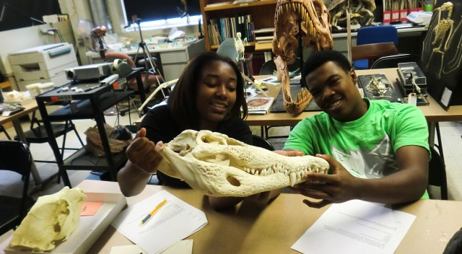
6. Outreach
Participants: Nizar, Paul, Paula
Junior Biocurator program, Summer 2012

Slide 61
Junior Biocurator Program
6 week program at the University of Chicago, in collaboration with Project Exploration (Sereno, Ibrahim)
5 students
Phase 1: Introduction to Morphological Biocuration
2 weeks
Phase 2: Biocuration Imaging (Photography)
3 weeks
Phase 3: Biocuration Imaging (Scanning)
1 week
Images to be used in Phenoscape anatomy ontology

Slide 62
SURE Program
10 week student internship program for American Indian undergraduate students at the University of South Dakota (Mabee)
2 students
Anatomy, whole mount preparation, dissection (fishes)
Data entry (Phenex), databases (Phenoscape KB; OMIM), literature reviews
Weekly lectures on fin/limb development, genes
Human limb phenotype related to fin phenotypes
Poster presentations
Paired fin loss data available in Phenoscape KB
Notes:
http://www.sanfordresearch.org/education/undergraduates/sure/; The University of South Dakota and Sanford Research is home to the Summer Undergraduate Research Experience (SURE), a unique opportunity for American Indian undergraduate students to receive hands-on research experience and mentoring in a cross-disciplinary training program (biomedical or behavioral research).
Fin loss data: http://kb.phenoscape.org/taxon_annotations?filter%5Bpublications%5D%5B0%5D=PSPUB%3A0000167

Slide 63
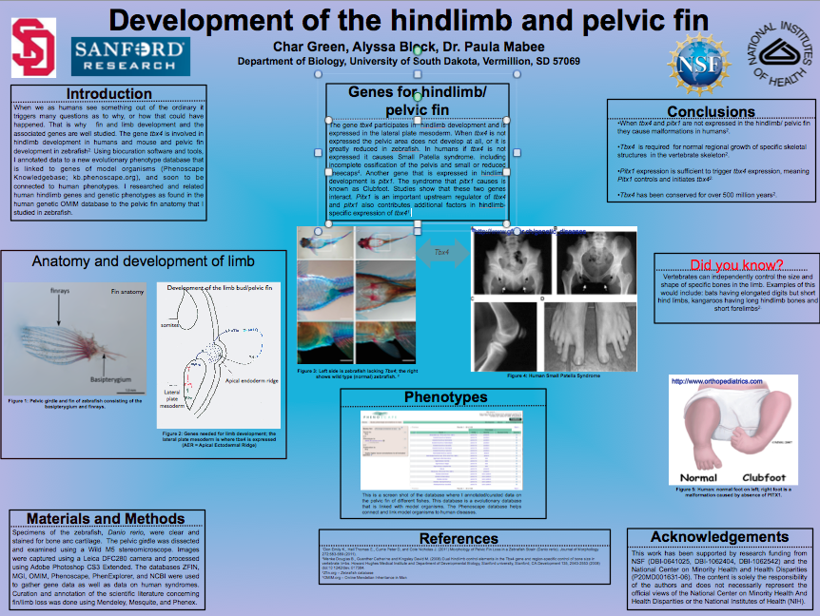
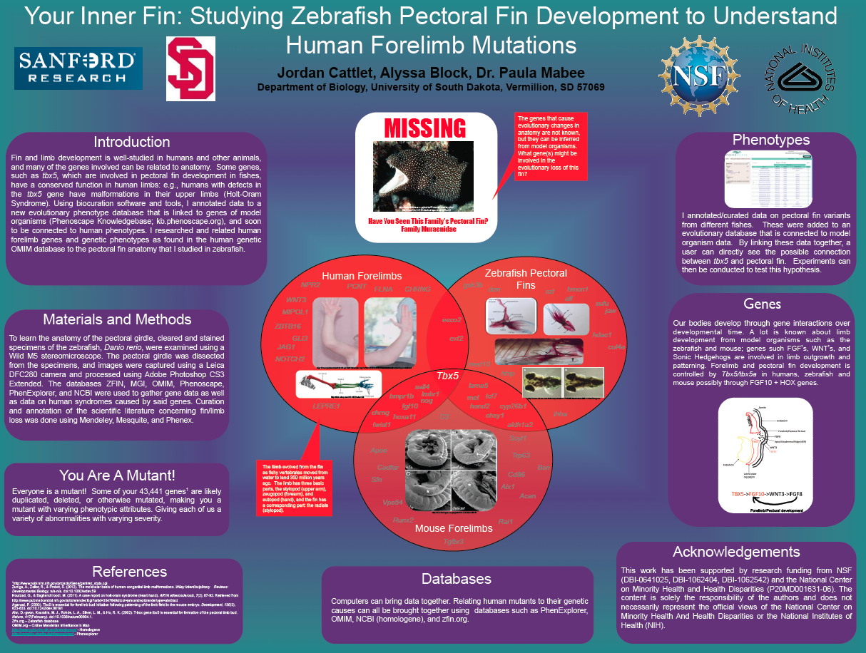

Slide 64
7. Knowledgebase reasoning & development
Participants: Jim, Chris, Hilmar
Goal:
Integrate the ontologies, homology assertions, EQ phenotype annotations, model organism genes and phenotypes, wild-type gene expression, and semantic search tool into a knowledgebase (KB).
The KB will enable discovery through multiple machine and human interfaces.

Slide 65
kb.phenoscape.org
Current “production” system
OBD relational database
Java-based web services application: JSON data
Web interface: Ruby on Rails
Interface subjected to several rounds of user testing
Reasoning process: Perl/SQL materialization of inferred statements
Limitations on semantics, scalability

Slide 66
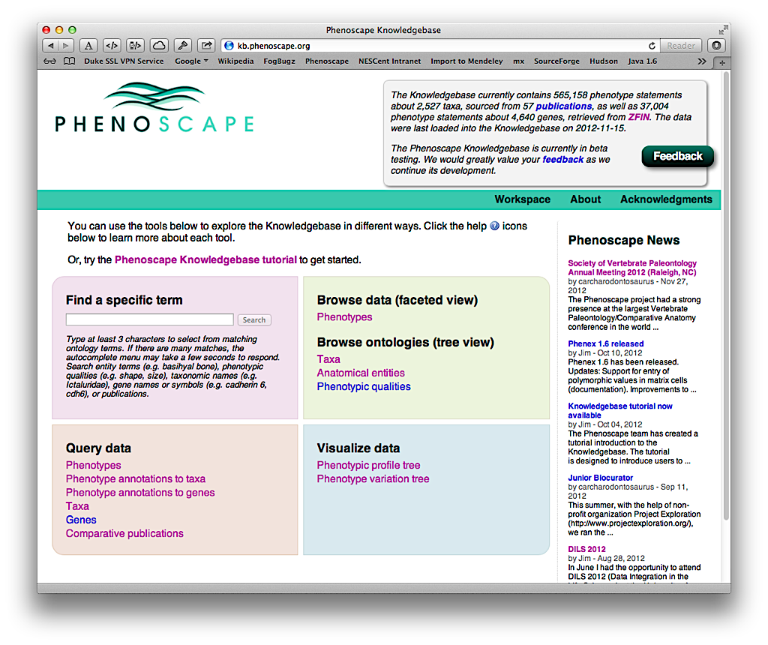

Slide 67
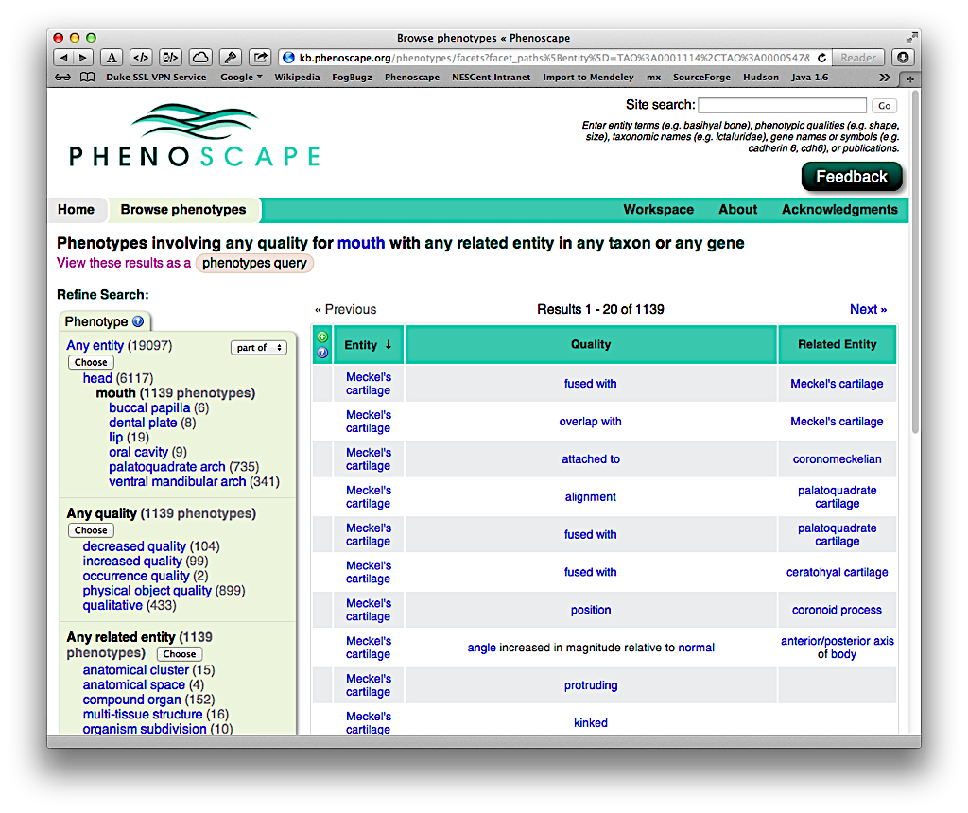

Slide 68
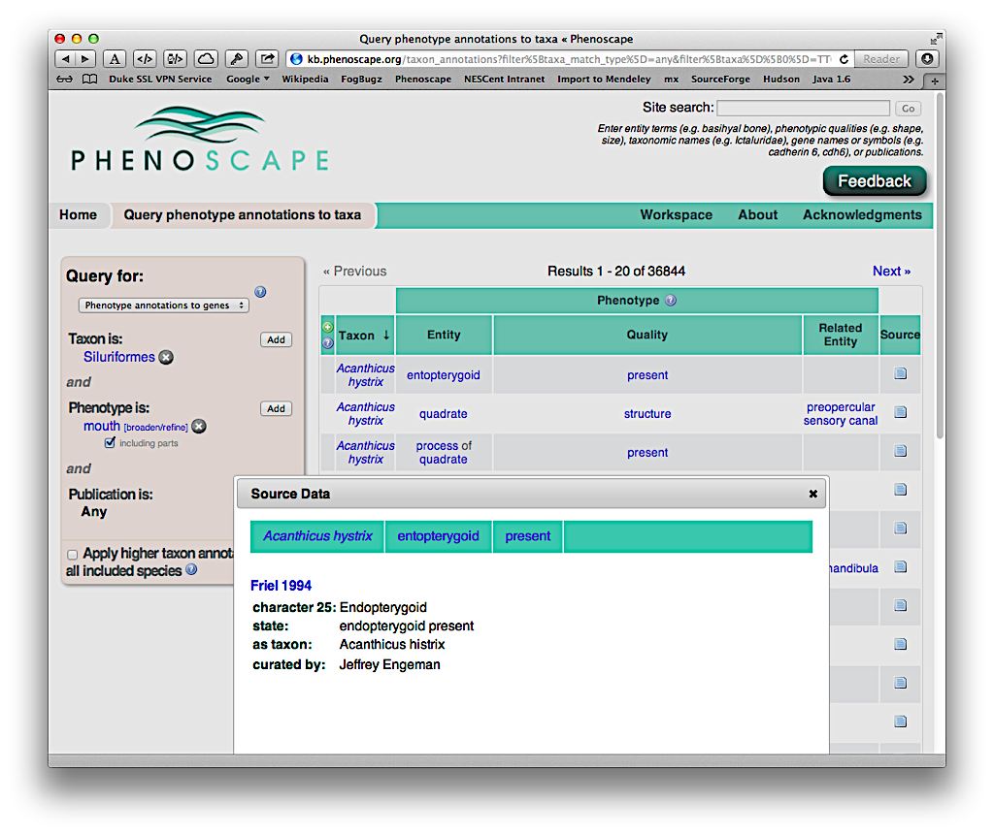

Slide 69
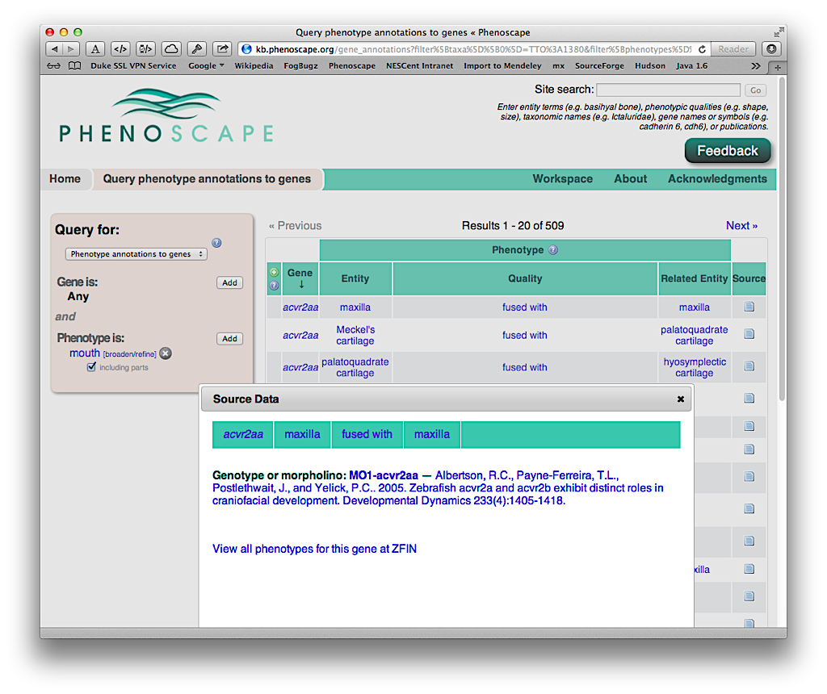

Slide 70
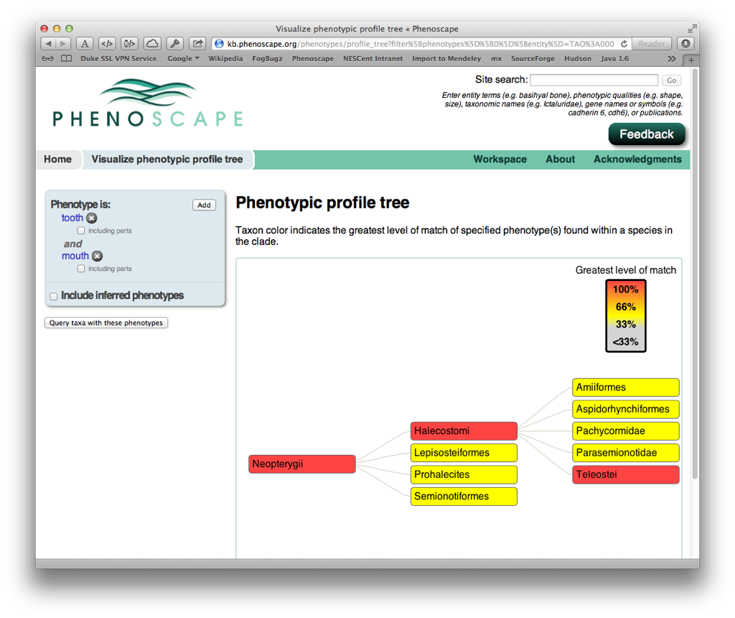
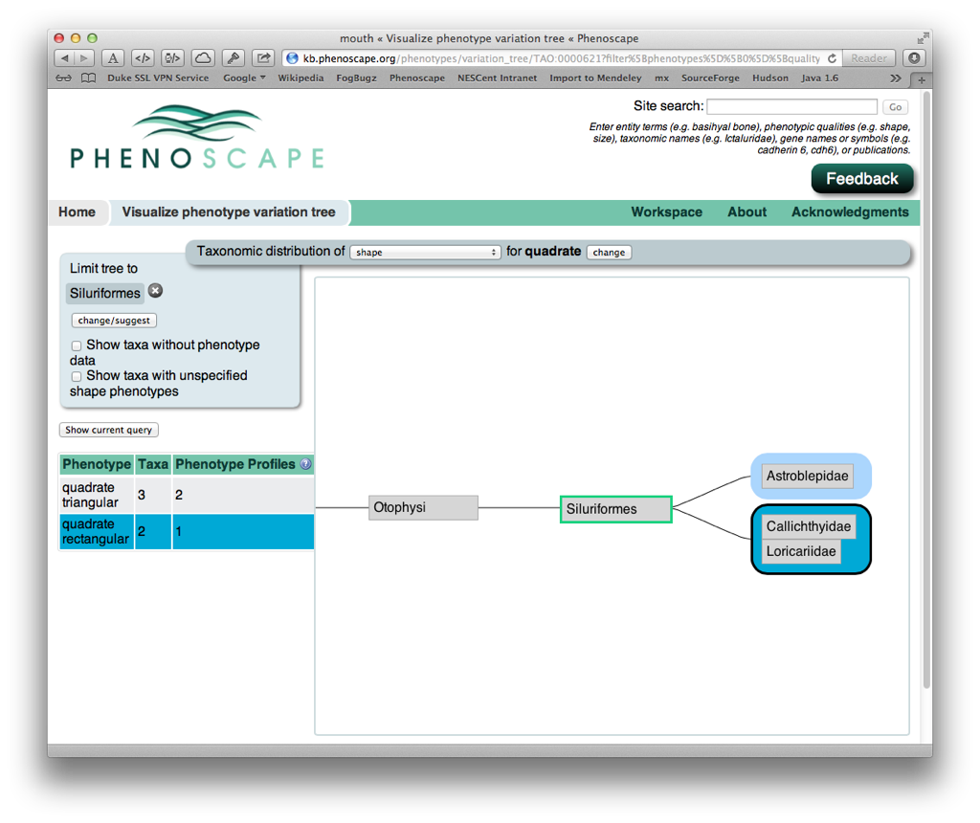

Slide 71
Current focus
Move data and reasoning to RDF/OWL
Address issues with scalability, expressivity, data standardization/reusability
All data downloadable in bulk: https://github.com/phenoscape/phenoscape-kb
Defer development of new complex user interfaces until driving projects emerge from collaboration workshop

Slide 72
Progress since April 2012
RDF/OWL KB build pipeline maturing
Configurable system for downloading ontologies and data, converting to OWL, performing pre-reasoning, loading into triple-store
Now incorporates Uberon ontology, evolutionary data, ZFIN gene expression data
Adopted BigData RDF triple-store
Adaptation of web interfaces to SPARQL query service, in progress
Active discussion of optimal data import strategies for combining data from model organism databases
Added curator attribution to existing KB website

Slide 73
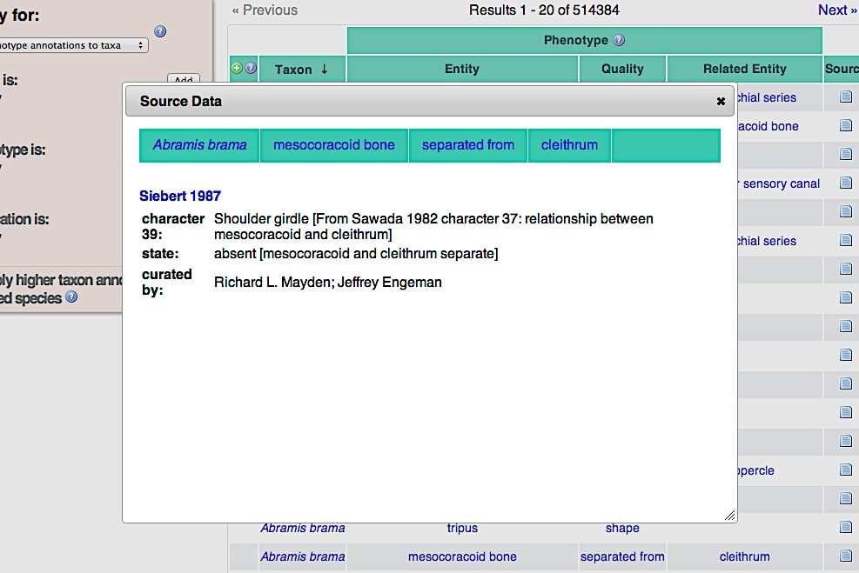

Slide 74
Next six months
Complete addition of MOD data to OWL knowledgebase
ZFIN, MGI, Xenbase phenotypes and gene expression
HPO (human) annotations
Advance from currently experimental SPARQL-based web interfaces to beta-quality website which provides much of the functionality of existing OBD-based system

Slide 75
III. Upcoming plans

Slide 76
Report of Phenoscape Scientific Advisory Board (27th April 2012)
Consider other large scale sources of structured data (Todd)
Further analyze candidate genes by incorporating gene set and pathway analysis for additional value to users (Todd)
Outreach, identification of user groups and real-life use-cases (Todd)
VAO and Uberon merge into one cross-species anatomy (Melissa)
Quality of the phenotype data capture, annotations (Alex)
Capturing inter-individual variation within taxa (Alex)
Practicality and utility of capturing data from birds and humans (Melissa & Monte)
Distribution of effort into developing tools vs. data capture & curation (Todd)
Concern over ontology term brokering with the NCBO tools (Jim)
Improvement in the granularity of phenotype descriptions, PATO (Alex)
Notes:
Advisory board concluded that ‘Points 1,2,3 and 9 are the most pressing issues at the moment and should be addressed over the next year of the project.’

Slide 77
Collaboration Workshop
February 8-10, California Academy of Sciences
NSF supplement obtained to involve expert facilitators ($30K, KnowInnovation)
Identified participants who bring data, ideas, time and interest in collaboration
Confirmed outside participants (10)
Gill Berjerano, Stanford University
Stan Blum, California Academy of Sciences
Greg Carter , The Jackson Laboratory
Wyatt Clark, Indiana University
Matthew Harris, Harvard Medical School, Dept of Genetics
Hans Larsson, McGill University
Gavin Naylor, College of Charleston
David Parichy, Univ. Washington
Karen Sears, University of Illinois
Brian Sidlauskas, Oregon State
Plus roughly equal number of Phenoscape participants

Slide 78
Publications & presentations (since April 2012)
Papers:
Arighi CN et al. (in press) An Overview of the BioCreative 2012 Workshop Track III: Interactive Text Mining Task. Database
Dahdul WM et al. (in press) A unified anatomy ontology of the vertebrate skeletal system. PLoS ONE
Bertone MA et al. (in press) Matching arthropod anatomy ontologies to the Hymenoptera Anatomy Ontology: Results from a manual alignment. Database.
Posters, Conference talks, and Seminars:
Sereno, P, Ibrahim N, Mabee P, Vision T, Lapp H. "Phenoscape: A New Anatomical Ontology of Vertebrates”, Society of Vertebrate Paleontology, Raleigh NC, October 2012.
Dececchi TA, Balhoff J, Dahdul W, Ibrahim N, Lapp H, Midford P, Sereno P, Vision T, Westerfield M, Mabee P Blackburn D. “Phenoscape: bridging the gap between fossils and genes”, Society of Vertebrate Paleontology, Raleigh NC, October 2012.
Mabee PM "Synthesis of evolutionary and developmental data for fishes using new informatics tools” (oral presentation) World Congress of Herpetology, Vancouver BC, August 2012.
Balhoff JP, Dahdul WD, Lapp H, Mabee P, Midford P, Vision TJ, Westerfield M, and the Phenoscape Project Team. "The Phenoscape Knowledgebase: Integrating phenotypic data across taxonomy, from biodiversity to developmental genetics” (poster) DILS 2012, College Park, MD, June 2012.
See http://phenoscape.org/wiki/Publications_and_Posters

Slide 79
How can we:
Larger questions. How do we…
... create a community of KB users?
… make sure there is a case to stakeholders for sustainability?
… support curation of additional taxa and genetic models?
… incentivize contributions of data from other researchers?
… promote community participation in maintenance of ontologies and software?

